Slide 1
Welcome to the training
Major components in Chambers

Slide 2
First we will start with learning about the components.
Most commonly used components in chamber are as follows:-

Slide 3
PLC.
HMI.
Analog card/RS 485 module.
Transmitters for PT100 sensors.
Sensor card for Temp/RH sensors.
Relays , SSR & contactors.
Dry heater.
Boiler heater & Ecotronic humidifiers.
Compressors.
Door sensor, water level switch.
Float valve , solenoid water inlet valve.
Sensors(temperature and humidity )

Slide 4
PLC

Slide 5
Nomenclature at control panels
Nomenclature | Actual meaning
DH | Dry heater
BH | Boiler heater
CO | compressor
CM | Circulation motor
HT | High thermostat
LT | Low thermostat
SV | Solenoid valve
VP | Vacuum pump
L | Line/live supply
N | neutral
E | earthing
TL | Tube lights
UV | Ultraviolet lights

Slide 6
HMI

Slide 7
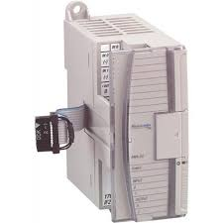
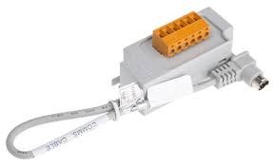
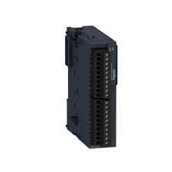
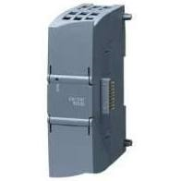
Analog card RS 485 module
AB
AB
Schneider
Siemens

Slide 8
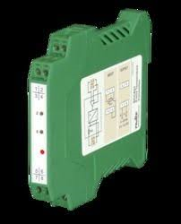
Transmitters
0 to 10 volts
4 to 20 mAmps

Slide 9
Sensor card for Temp/RH sensors.

Slide 10
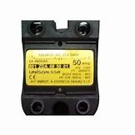
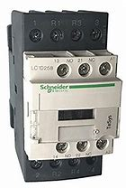
Relays , SSR & contactors.

Slide 11
Dry heater.

Slide 12
Boiler heater.

Slide 13
Compressors.

Slide 14
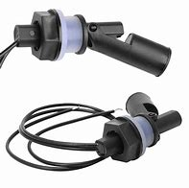
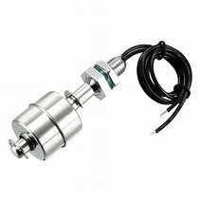
Door sensor, water level switch.

Slide 15
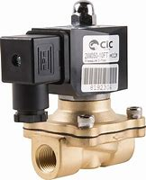
Float valve , solenoid water inlet valve.

Slide 16
Sensors(temperature and humidity )

