Slide 1

The name you can trust
Basic Troubleshooting Of Humidity Chamber

Slide 2
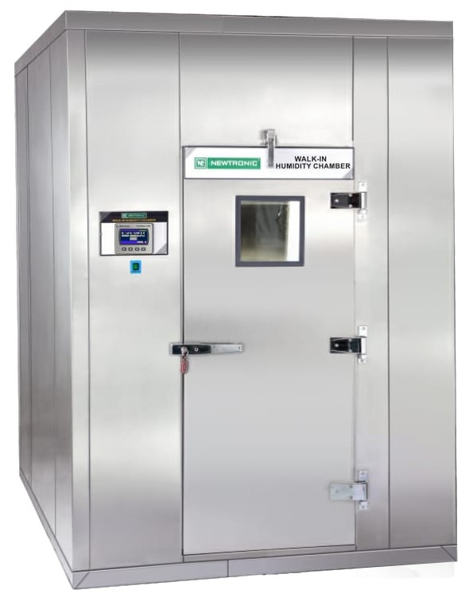
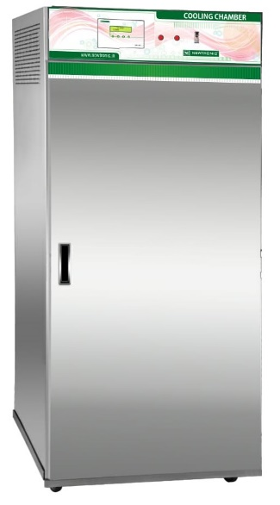
Humidity Chamber
Techinical Specification:-
Temperatuer Range : 20˚ to 60˚C
Temperature Accuracy: ±0.2˚C
Temperature Unifomity: ±1˚C
Humidity Range: 40% Rh to95%Rh
Humidity Accuracy: ± 2 % Rh
Humidity Unifomity: ±3 % Rh
Power Supply : 230/415 Volts, 50Hz main Supply. Also availible with 60 Hz cycle.
Optional Accessories:-
ICDAS- A Common Software .
8pt. Temperature Scanner
Stand by Cooling System with Auto Switch Over.
Door Access / Mobile alaret System
Remote alarm system.

Slide 3
Humidity Chamber
Humidity Chamber Component
1) PLC.
2) HMI.
3) Analog card.
4) Sensor card for Temp/RH sensors.
5) Relays , SSR & contactors.
6) Dry heater.
7) Boiler heater or Ecotronic humidifiers.
7) Compressors.
8) Door sensor.
9) Float valve Float switch.
10) Temperature and humidity sensors
11) High and Low Thermostat.
12) Hygrostat.

Slide 4
Humidity Chamber
Working Procedure.
1) Check All utility.
2) Switch ON UPS.
3) Set Required Set Temp. and Humidity.
4) Set Alarm Limit respectively Set Value.
5) Set Low Thermostat Below 10°C respectively set temp.
6) Set High Thermostat above 10°C respectively set temp.
7) Set Hygrostat above 10% respectively set Humidity
8) Switch ON Raw Power Supply.
9) PLC will give the commands to Compressor, Dry Heater and Humidifier Heater According to process value.
10) Once PLC reach set point , PLC reduce commands to maintain control accuracy.

Slide 5
Humidity Chamber
TEMPERATURE
Temperature overshooting
  For temperature overshooting check following systems.
  1) Air passages and sensor are not blocked by loaded samples.
  2) Low temperature safety thermostat (LT) setting 10 °C below set value.
  3) Dry heater (DH) solid state relay working. Check relay continuity, it should not be shorted.
  4) Cooling system ON.
  5) Check Condensor is not block by Dust. Clean the condensor by air blower or Water.
  6) Check Condensor motor working condition.
  7) Check the Compressor is working. Check compressor accessories.
  8) Check Gas Pressure By Using Proper Charging line and Proper pressure gauge.
  9) If Gas is not in system then First Check Leakage and Rectify and do the gas charging as per requirement.

Slide 6
Humidity Chamber
TEMPERATURE
Temperature undershooting
  For temperature undershooting check following systems.
  1) Air passages and sensor are not blocked by loaded samples.
  2) High temperature safety thermostat (HT) setting 10°C above set value.
  3) Check Dry Heater Safety relay (DHS) working. It should be ON if current temperature is less than set temperature.
  4) Dry heater (DH) solid state relay working. When PLC output is ON the indication on relay should be ON.
  5) Check Dry Heater AMPS by Using Multimeter when Dry heater is ON condition.

Slide 7
Humidity Chamber
Temperature accuracy
  If temperature of chamber is continuously varying by more than 2°C check following systems.
  1) Circulation motor working
  2) Controlling sensor not blocked.
  3) Air passages and sensor are not blocked by loaded samples.
  4) Dry heater (DH) solid state relay working. Check relay continuity, it should not be shorted.
  5) Check PID Parameters.

Slide 8
Humidity Chamber
HUMIDITY
Humidity overshooting
  1) Air passages and sensor are not blocked by loaded samples.
  2) Check cooling System. sufficient cooling is present.
  3) Humidifier (BH) solid state relay working. Check relay continuity, it should not be shorted.
  4) Check Drain Tray. Drain water is properly drain from Drain line.
  5) Check PID parameters.

Slide 9
Humidity Chamber
HUMIDITY
Humidity undershooting
  1) Check water supply and water level in the tank. Tank level indicator Water Level 1 and Water Level 2 should be OK in input window.
  2) Sudden inrush of fresh water due to faulty float valve.
  3) Air passages and sensor are not blocked by loaded samples.
  4) Check Humidifier Safety relay (DHS) working. It should be ON if current humidity is less than set humidity.
  5) Humidifier (BH) solid state relay working. When PLC output is ON and indication on relay should be ON.
  6) Check PID parameters.

Slide 10
Humidity Chamber
HUMIDITY
Humidity accuracy
  If humidity of chamber is continuously varying by more than 5%RH check following systems.
  1) Circulation motor working
  2) Air passages and sensor are not blocked by loaded samples.
  3) Humidifier (BH) solid state relay working. Check relay continuity, it should not be shorted.
  4) Check Cooling System. Compressor is not tripping again and again.
  5) Check PID value.

Slide 11
Humidity Chamber
Humidifier Heater Change Over
  1) If Humidifier 1 (BH1) is continuously ON for more than 90 minutes and Humidity not Increase PLC will conclude fault in the Humidifier 1 and will change over to Humidifier 2 (BH2)
  2) If Humidifier 2 (BH2) is continuously ON for more than 90 minutes and Humidity not Increase PLC will conclude fault in the Humidifier 2 and will change over to Humidifier 1 (BH1)
  3) Also change over is happening as per Schedule changer over setting.
  a) Mains Fail
  b) Daily Basis
  c) Weekly Basis
  d) AlterNet weekly
  e) Monthly
  4) In case of “ Humidifier circuit failure” alarm is occur humidifier change over is happening .

Slide 12
Humidity Chamber
Cooling System
  1) Standby and regular cooling system will remain on if measured temperature is more than 2°C than set temperature.
  2) If Compressor 1 (CO1) is continuously ON for more than 90 minutes and temp. is not decrease PLC will conclude fault in the Compressor 1 and will change over to Compressor 2 (CO2)
  2) If Compressor 2 (CO2) is continuously ON for more than 90 minutes and temp. is not decrease PLC will conclude fault in the Compressor 2 and will change over to Compressor 1 (CO1)
  Also change over is happening as per Schedule changer over setting.
  a) Mains Fail
  b) Daily Basis
  c) Weekly Basis
  d) AlterNet weekly
  e) Monthly
  4) In case of “ Compressor circuit failure” alarm is occur Compressor change over is happening .

Slide 13
Humidity Chamber
Alarm
LT Trip alarm / Compressor Circuit failure
  This is Low Temperature safety thermostat trip alarm. In this case check following systems.
  1) Circulation motor working
  2) Low Temperature safety thermostat set on 10Deg below set temperature.
  3) In case Temp. is continues decrease check Dry heater (DH) solid state relay working condition.
  3) Check Compressors relay feedback. When PLC output 10 and or 11 is ON at that time relay feedback 5 and 6 should be ON respectively. if PLC not getting feedback PLC will give Compressor circuit failure alarm/ LT trip alarm.
  Check status
    Compressor CO1(O/P 10) : ON/OFF
    Feedback (I/P 5) : ON/OFF
    Compressor CO2(O/P 11) : ON/OFF
    Feedback (I/P 6) : ON/OFF

Slide 14
Humidity Chamber
Alarm
HT Trip alarm /Dry Heater Circuit failure
  This is High Temperature safety thermostat trip alarm. In this case check following systems.
  1) Circulation motor working
  2) High Temperature safety thermostat set on 10Deg above set temperature.
  3) In case Temp. is continues increase check Dry heater (DH) solid state relay working condition Check relay continuity, it should not be shorted.
  4) Check Dry heater safety relay or contactor, if PLC not getting feedback PLC will give Dry heater circuit failure alarm.
  Check status
    Dry Heater DH (O/P 2) : ON/OFF
    Feedback (I/P 3) : ON/OFF

Slide 15
Humidity Chamber
Alarm
HH Trip alarm/Humidifier circuit failure.
This is High Humidity safety trip alarm. In this case check following systems.
1) Circulation motor working.
2) High Humidity safety Hygrostat set on 10% above set Humidity.
3) In case Humidity is continues increase check Humidifier (BH) solid state relay working condition Check relay continuity, it should not be shorted.
4) Check Humidifier safety relay or contactor, if PLC not getting feedback PLC will give Humidifier circuit failure alarm.
5) Check Cooling System working condition. compressor is tripping.
  Check status
    Boiler Heater BH1 (O/P 3) : ON/OFF
    Feedback (I/P 1 ) : ON/OFF
    Boiler Heater changer over selection (O/P 1) : ON/OFF
    Feedback (I/P 2) : ON/OFF

Slide 16
Humidity Chamber
Alarm
Water Level Fail
  If the water is not sufficient in either Water tank or Humidifier tank then this alarm is generated. Check water level and its feedback status in Input window.
  Check Float switch connectivity.
  Clean Float switch if there any scaling.
  Check status
    Water Level 1(I/P 7) : ON
    Water Level 2 (I/P 8) : ON

Slide 17
Humidity Chamber
Temp./Humidity Sensors.
Controlling sensor
Incase Temp. and Humidity sensor are showing -99.9 check following point.
  1) If Temp. and Humidity both showing -99.9 check sensor working condition.
  2) Check Sensor to Sensor card Communication cable.
  3) Check 9 Pin wiring connection.
  3) Check Analog card.
  Scanner Sensor.
  If Scanner sensor are showing -99.9 check following point.
  1) If Temp. and humidity both are showing -99.9 check sensor working condition.
  2) Check sensor to sensor card communication cable.
  3) Check 9 Pin wiring connection.
  4) Check scanner sensor ID no.
  5) All scanner sensors are showing -99.9 check sensor card and check sensor card to PLC communication cable.

Slide 18
Thank You
Thank You

