Slide 1

The name you can trust
Cooling system and basic troubleshooting.

Slide 2
Product Introduction and Components
1) Walk-In Cooling Chamber.
2) Deep Freezer -20°C.
3) Walk-In Deep Freezer.
4) Ultra Low Deep Freezer -80°C

Slide 3
Components
Major Components Use In Chambers.
1) PLC.
2) HMI.
3) Analog card.
4) Temp. Transmitter.
5) contactors.
6) Compressors.
7) LP/HP switch.
8) Door sensor.
9) Door Heater.
10) PT 100 Sensor.
11) Low Thermostat.
12) Gylacol Liquid.

Slide 4
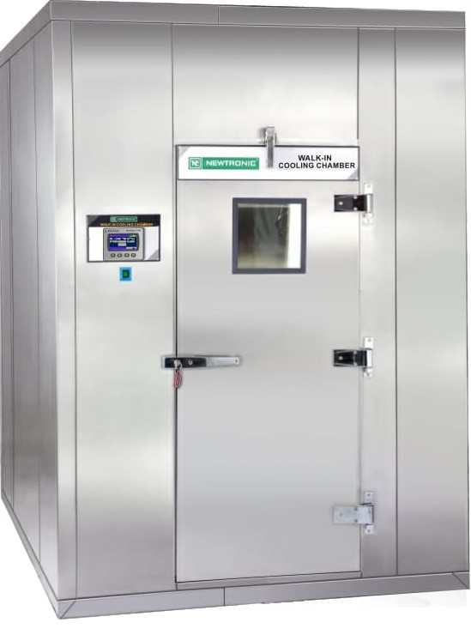
Walk-In Cooling Chamber
Techinical Specification:-
Temperatuer Range : 2˚-8˚C
Temperature Accuracy: ±0.5˚C
Temperature Unifomity: ±1˚C
Power Supply : 230/415 Volts, 50Hz main Supply. Also awailible with 60 Hz cycle.
Optional Accessories:-
ICDAS- A Common Software .
8pt. Temperature Scanner
Stand by Cooling System with Auto Switch Over.
Door Access / Mobile alaret System
Remote alarm system.

Slide 5
Walk-In Cooling Chamber
Working Procedure.
1) Check All utility.
2) Switch ON UPS.
3) Set Required Set Condition.(5°C)
4) Set Alarm Limit respectively Set Value.
5) Set Low Thermostat Below 2°C.
6) Switch ON Raw Power Supply.
7) Compressor no. 1 will start and after few sec. compressor 2 will also start.
8) Once Temp. come within 2°C Standby Compressor will cut OFF automatically.
9) Regular compressor will pull down the temp. till set value.
10) Regular compressor will cut off once temp. reach set point or as per Comp. Hysteresis.
e.g. Set Point is 5°C and com. Hysteresis is 0.2 then compressor will cut off when temp. comes down 4.8°C and below.
Regular compressor will start again when temp. will increase 5°C and above.

Slide 6
Walk-In Cooling Chamber
Features.
1) Stand By Cooling System.
To Avoid Break Down and to know the healthiness of compressor, provided stand by cooling system with schedule change over.
If Compressor no.1 (CO1) is running and PLC also get the feed back but still temp. not decrease more then 90Mins. PLC automatically change over the compressor no. 2 (CO2) with compressor change over alarm (Audio and Visual alarm) and compressor no. 2 will start to pull down the temp.
2) Schedule Change over as below.
a) Mains Fail.
b) Daily basis.
c) Weekly Basis.
d) AlterNet Weekly.
e) Monthly.

Slide 7
Walk-In Cooling Chamber
Door Heater.
To Avoid water Condensation on Door we provided heater in Door farm.
a) Door heater controlled by PLC.
b) Door Heater ON/OFF status is available in set Parameter Option.
c) Use Proper User ID and Password To enter the parameter and change the ON/OFF status or set the Out put as per requirement.
Low Pressure/High Pressure switch.
To Avoid Major Damage In compressor we Provided LP/HP switch In Condensing Unit.
Low Pressure.(LP)
In case Refrigerant gas is leak and there is no gas in system compressor will trip on LP and indication will glow on Condensing Unit.

Slide 8
Walk-In Cooling Chamber
High Pressure.
When compressor internal head pressure is increase, compressor will trip on HP and indication will glow on condensing unit.
Compressor will trip on HP below mention point.
a) Condensor is block with dust.
Clean the condensor by air blower or water.
b) Condensor motor is not working condition.
If Condensor motor is not working condition replace the motor.

Slide 9
Walk-In Cooling Chamber
Basic Troubleshooting.
Temperature overshooting
  For temperature overshooting check following Point.
  1) Air passages and sensor are not blocked by loaded samples.
  2) Low temperature safety thermostat (LT) setting Below 2°C.
  3) Cooling system ON.
  4) Check Condensor is not block by Dust. Clean the condensor by air blower or Water.
  5) Check Condensor motor working condition.
  6) Check the Compressor is working. Check compressor accessories.
  7) Check Gas Pressure By Using Proper Charging line and Proper pressure gauge.
  8) If Gas is not in system then First Check Leakage and Rectify and do the gas charging as per requirement.
  9) Check Door Heater is shorted.

Slide 10
Walk-In Cooling Chamber
TEMPERATURE
Temperature undershooting
  For temperature undershooting check following point.
  1) Air passages and sensor are not blocked by loaded samples.
  2) Check Circulation motor working condition.
  3) Check Compressor safety contactor stuck.
  4) Check Compressor Hysteresis In PID parameters.

Slide 11
Walk-In Cooling Chamber
Alarm
LT Trip alarm / Compressor Circuit failure
  This is Low Temperature safety thermostat trip alarm. In this case check following point.
  1) Circulation motor working.
  2) Check Low Temperature safety thermostat setting. low thermostat set below 2C.
  3) Check Compressors relay feedback. When PLC output 10 and or 11 is ON at that time relay feedback 5 and 6 should be ON respectively. if PLC not getting feedback PLC will give Compressor circuit failure alarm/ LT trip alarm.
  Check status
    Compressor CO1(O/P 10) : ON/OFF
    Feedback (I/P 5) : ON/OFF
    Compressor CO2(O/P 11) : ON/OFF
    Feedback (I/P 6) : ON/OFF
4) Check LP/HP switch.

Slide 12
Walk-In Cooling Chamber
INPUTS | Actual meaning
I0 | Stand by compressor
I1
I2 | COM 1
I3 | COM 2
I4 | MAINS
I5 | Door proximity sensor
I6 | Magnetic door release

Slide 13
Walk-In Cooling Chamber
Outputs | Actual meaning
O0 | Alarm hooter
O1
O2 | Door heater
O3 | DEFROST
O4
O5 | Remote alarm
O6 | Magnetic Door lock
O7
O8 | CO1
O9 | CO2

Slide 14
Thank You
Thank You

Slide 15
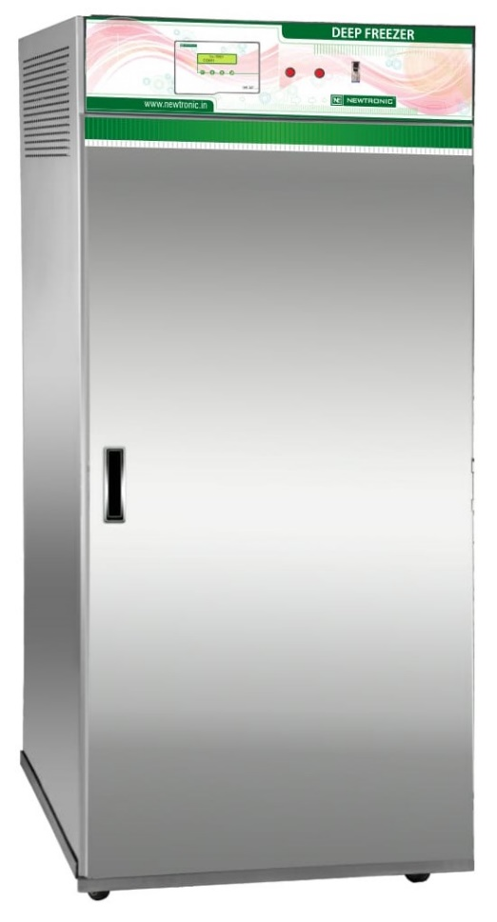
Deep Freezer
Techinical Specification:-
Temperatuer Range : -20˚ to 0˚C
Temperature Accuracy: ± 3˚C
Temperature Unifomity: ±5˚C
Power Supply : 230/415 Volts, 50Hz main Supply. Also availible with 60 Hz cycle.
Optional Accessories:-
ICDAS- A Common Software .
8pt. Temperature Scanner
Stand by Cooling System with Auto Switch Over.
Door Access / Mobile alaret System
Remote alarm system.

Slide 16
Deep Freezer
Working Procedure.
1) Check All utility.
2) Switch ON UPS.
3) Set Required Set Condition.(-20°C)
4) Set Alarm Limit respectively Set Value.
5) Switch ON Raw Power Supply.
6) Compressor no. 1 will start and after few sec. compressor 2 also start Automatically.
7) Once Temp. come within 2°C Standby Compressor will cut OFF automatically.
8) Regular compressor will pull down the temp. till set value.
9) Regular compressor will cut off once temp. reach set point or as per set Comp. Hysteresis
e.g. Set Point is -20°C and Temp. Hysteresis is 0.2 then compressor will cut off when temp. comes -20.2°C.
Regular compressor will start again when temp. will increase -20.0°C and above.

Slide 17
Deep Freezer
Features.
1) Stand By Cooling System.
To Avoid Break Down and to know the healthiness of compressor, provided stand by cooling system with schedule change over.
If Compressor no.1 (CO1) is running and PLC also get the feed back but still temp. not decrease more then 90Mins. PLC automatically change over the compressor no. 2 (CO2) with compressor change over alarm (Audio and Visual alarm) and compressor no. 2 will start to pull down the temp.
2) Schedule Change over as below.
a) Mains Fail.
b) Daily basis.
c) Weekly Basis.
d) AlterNet Weekly.
e) Monthly.

Slide 18
Deep Freezer
Door Heater.
To Avoid water Condensation Door we provided heater in Door farm.
a) Door heater controlled by PLC.
b) Door Heater ON/OFF status is available in set Parameter Option.
c) Use Proper User ID and Password To enter the parameter and change the ON/OFF status or set the Out put as per requirement.
Auto Defrosting.
To Avoid Ice formation on cooling coil, we provided Auto defrosting system. Once Temp. is below 15C Auto defrosting function will start as per define time.
e.g. Defrost Delay Time:- 5400sec. And Defrost Time:- 10sec.
If Defrost delay time set on 5400 sec. and Defrost time is 10sec. means every 90mins Defrosting will start and hot gas pass from the cooling coil for 10 sec.
While Defrosting cycle Liquid line will close by solonide valve and hot gas line will open. For 10sec.

Slide 19
Deep Freezer
Basic Troubleshooting.
Temperature overshooting
  For temperature overshooting check following Point.
  1) Air passages and sensor are not blocked by loaded samples.
  2) Cooling system ON.
  3) Check Condensor is not block by Dust. Clean the condensor by air blower or Water.
  4) Check Condensor motor working condition.
  5) Check the Compressor is working. Check compressor accessories.
  6) Check Gas Pressure By Using Proper Charging line and Proper pressure gauge.
  7) If Gas is not in system then First Check Leakage and Rectify and do the gas charging as per requirement.
  8) Check Door Heater is shorted.

Slide 20
Deep Freezer
TEMPERATURE
Temperature undershooting
  For temperature undershooting check following point.
  1) Air passages and sensor are not blocked by loaded samples.
  2) Check Circulation motor working condition.
  3) Check Compressor safety contactor is stuck.
  4) Check Compressor Hysteresis In PID parameters.

Slide 21
Deep Freezer
Alarm
LT Trip alarm / Compressor Circuit failure
  This is Low Temperature safety thermostat trip alarm. In this case check following point.
  1) Circulation motor working
  2) Check Compressors relay feedback. When PLC output 10 and or 11 is ON at that time relay feedback 5 and 6 should be ON respectively. if PLC not getting feedback PLC will give Compressor circuit failure alarm/ LT trip alarm.
  Check status
    Compressor CO1(O/P 10) : ON/OFF
    Feedback (I/P 5) : ON/OFF
    Compressor CO2(O/P 11) : ON/OFF
    Feedback (I/P 6) : ON/OFF

Slide 22
Thank You
Thank You

Slide 23
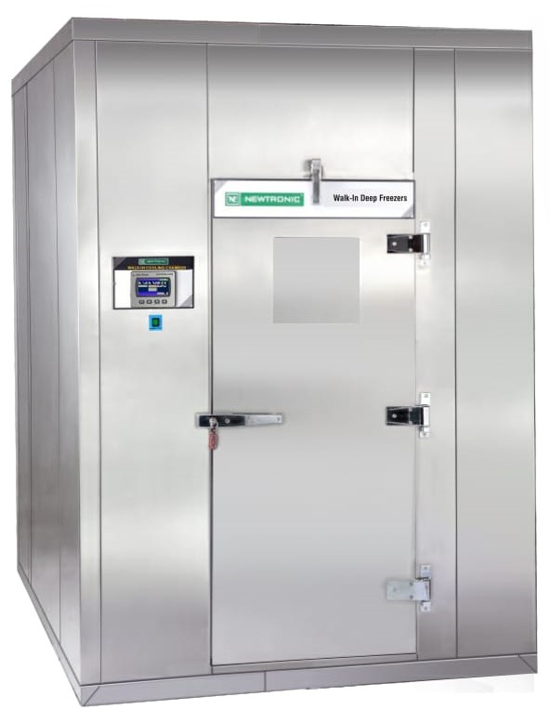
Walk-In Deep Freezer
Techinical Specification:-
Temperatuer Range : -20˚ to 0˚C
Temperature Accuracy: ± 3˚C
Temperature Unifomity: ±5˚C
Power Supply : 230/415 Volts, 50Hz main Supply. Also availible with 60 Hz cycle.
Optional Accessories:-
ICDAS- A Common Software .
8pt. Temperature Scanner
Stand by Cooling System with Auto Switch Over.
Door Access / Mobile alaret System
Remote alarm system.

Slide 24
Walk-In Deep Freezer
Working Procedure.
1) Check All utility.
2) Switch ON UPS.
3) Set Required Set Condition.(-20°C)
4) Set Alarm Limit respectively Set Value.
5) Switch ON Raw Power Supply.
6) Compressor no. 1 will start and after few sec. compressor 2 also start Automatically.
7) Once Temp. come within 2°C Standby Compressor will cut OFF automatically.
8) Regular compressor will pull down the temp. till set value.
9) Regular compressor will cut off once temp. reach set point or as per set Comp. Hysteresis
e.g. Set Point is -20°C and Temp. Hysteresis is 0.2 then compressor will cut off when temp. comes -20.2°C.
Regular compressor will start again when temp. will increase -20.0°C and above.

Slide 25
Walk-In Deep Freezer
Features.
1) Stand By Cooling System.
To Avoid Break Down and to know the healthiness of compressor, provided stand by cooling system with schedule change over.
If Compressor no.1 (CO1) is running and PLC also get the feed back but still temp. not decrease more then 90Mins. PLC automatically change over the compressor no. 2 (CO2) with compressor change over alarm (Audio and Visual alarm) and compressor no. 2 will start to pull down the temp.
2) Schedule Change over as below.
a) Mains Fail.
b) Daily basis.
c) Weekly Basis.
d) AlterNet Weekly.
e) Monthly.

Slide 26
Walk-In Deep Freezer
Door Heater.
To Avoid water Condensation Door we provided heater in Door farm.
a) Door heater controlled by PLC.
b) Door Heater ON/OFF status is available in set Parameter Option.
c) Use Proper User ID and Password To enter the parameter and change the ON/OFF status or set the Out put as per requirement.
Auto Defrosting.
To Avoid Ice formation on cooling coil, we provided Auto defrosting system. Once Temp. is below 15C Auto defrosting function will start as per define time.
e.g. Defrost Delay Time:- 5400sec. And Defrost Time:- 10sec.
If Defrost delay time set on 5400 sec. and Defrost time is 10sec. means every 90mins Defrosting will start and hot gas pass from the cooling coil for 10 sec.
While Defrosting cycle Liquid line will close by solonide valve and hot gas line will open. For 10sec.
Drain Heater.
We Provided Drain Heater in Drain line. Drain heater is working on Auto defrosting time.

Slide 27
Walk-In Deep Freezer
Basic Troubleshooting.
Temperature overshooting
  For temperature overshooting check following Point.
  1) Air passages and sensor are not blocked by loaded samples.
  2) Cooling system ON.
  3) Check Condensor is not block by Dust. Clean the condensor by air blower or Water.
  4) Check Condensor motor working condition.
  5) Check the Compressor is working. Check compressor accessories.
  6) Check Gas Pressure By Using Proper Charging line and Proper pressure gauge.
  7) If Gas is not in system then First Check Leakage and Rectify and do the gas charging as per requirement.
  8) Check Door Heater is shorted.
  9) Check Auto defrosting setting.

Slide 28
Walk-In Deep Freezer
TEMPERATURE
Temperature undershooting
  For temperature undershooting check following point.
  1) Air passages and sensor are not blocked by loaded samples.
  2) Check Circulation motor working condition.
  3) Check Compressor safety contactor stuck.
  4) Check Compressor Hysteresis In PID parameters.

Slide 29
Walk-In Deep Freezer
Alarm
LT Trip alarm / Compressor Circuit failure
  This is Low Temperature safety thermostat trip alarm. In this case check following point.
  1) Circulation motor working
  2) Check Compressors relay feedback. When PLC output 10 and or 11 is ON at that time relay feedback 5 and 6 should be ON respectively. if PLC not getting feedback PLC will give Compressor circuit failure alarm/ LT trip alarm.
  Check status
    Compressor CO1(O/P 10) : ON/OFF
    Feedback (I/P 5) : ON/OFF
    Compressor CO2(O/P 11) : ON/OFF
    Feedback (I/P 6) : ON/OFF

Slide 30
Walk-In Deep Freezer
INPUTS | Actual meaning
I0 | Stand by compressor
I1
I2 | COM 1
I3 | COM 2
I4 | MAINS
I5 | Door proximity sensor
I6 | Magnetic door release

Slide 31
Walk-In Deep Freezer
Outputs | Actual meaning
O0 | Alarm hooter
O1
O2 | Door heater
O3 | DEFROST
O4
O5 | Remote alarm
O6 | Magnetic Door lock
O7
O8 | CO1
O9 | CO2

Slide 32
Thank You
Thank You

Slide 33
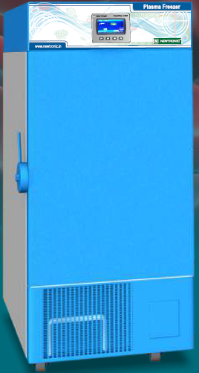
Ultra Low Deep Freezer
Techinical Specification:-
Temperatuer Range : -80˚C to -50˚C
Temperature Accuracy: ± 3˚C
Temperature Unifomity: ± 10˚C
Power Supply : 230 V, 50Hz main Supply. Also availible with 60 Hz cycle.
Optional Accessories:-
ICDAS- A Common Software .
Mobile alaret System
Remote alarm system.
Remote View and Alarm System
Application:-
Necessary for a wide range of life science, pharmacy, biological, medical, clinical, and industrial applications.

Slide 34
Ultra Low Deep Freezer
500ltr Ultra Low Deep freezer.
Refrigeration System Working on 2 stage.
1) High Stage.
2) Low Stage.
High stage component.
a) Compressor/Make:- Tecumseh CAJ2464Z
b) Skin Condensor. 3/8”
c) Condenser coil. 14” * 23” * 4Row
d) Drier. 3/8”
e) Capilary/0.044*10 feet*2 No.
f) Heat Exchanger. (High stage Evaporator)

Slide 35
Ultra Low Deep Freezer
g) Suction Accumulator.
h) Gas:- R 404a
i) Suction pressure:- 10PSI To 15PSI
j) Discharge Pressure:- 170PSI To 190PSI
Low Stage Component.
a) Compressor/Make:- Embrao NJ2212GK
b) Skin Condensor.- 3/8”
c) Oil separator.
d) Condenser.(High stage Evaporator)

Slide 36
Ultra Low Deep Freezer
e) Drier. 3/8”
f) Capilary/0.044*10 Feet*2 No.
g) Evaporator Coil. – 3/8”
h) Gas:- R 508B (Suva 95).
i) Suction Pressure :- -2 PSI To 0 PSI
j) Discharge Pressure:- 120PSI To 130PSI

Slide 37
Ultra Low Deep Freezer
Working Principle
a) Switch On UPS supply.
b) Set Required set Condition.(80°C)
c) Set Alarm Limit as per set condition.
d) Switch ON Raw Power.
e) When Mains is ON ,high stage(CO1) compressor will start first.
d) When High stage compressor reached low temp. -15°C and below in Evaporator (Heat exchanger) PLC give the command to the Low Stage Compressor(CO2).
e) When the low stage compressor is switched ON, the Actual chamber inside temp. start to decrease.
f) If the High stage compressor temp. goes up -15°C and above) PLC switch off the low stage compressor.
g) This cycle repeats till the condensation of low stage refrigerant stabilizes and chamber temp. is maintained.

Slide 38
Ultra Low Deep Freezer
Basic Troubleshooting.
Temperature overshooting
  For temperature overshooting check following Point.
  1) sensor are not blocked by loaded samples.
  2) Cooling system ON.
  3) Check Condensor is not block by Dust. Clean the condenser and Condensor Filter net by air blower or Water.
  4) Check Condensor motor working condition.
  5) Check the High stage and low stage Compressor is working. Check compressor accessories.
  6) Check Gas Pressure of both compressor By Using Proper Charging line and Proper pressure gauge.
  7) If Gas is not in system then First Check Leakage and Rectify and do the gas charging as per requirement.

Slide 39
Ultra Low Deep Freezer
TEMPERATURE
Temperature undershooting
  For temperature undershooting check following point.
  1) sensor are not blocked by loaded samples.
  2) Check Compressor safety contactor is stuck.
  3) Check Compressor Hysteresis In PID parameters.

Slide 40
Ultra Low Deep Freezer
INPUTS | Actual meaning
I0
I1
I2 | COM 1
I3 | COM 2
I4 | MAINS
I5 | Door proximity sensor
I6

Slide 41
Ultra Low Deep Freezer
Outputs | Actual meaning
O0 | Alarm hooter
O1
O2 | Door heater
O3
O4
O5 | Remote alarm
O6 | Magnetic Door lock
O7
O1.0 | CO1
O1.1 | CO2

Slide 42
Thank You
Thank You

