Slide 1
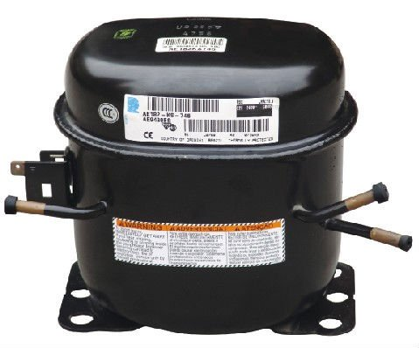
New Compressor Conditions
Check Should be end closed condition all ports
Damage & pinch free all pipes
Keep the Compressor always in the vertical direction. don't keep horizontal directions.

Slide 2
Compressor Replacement Process
Safely remove / Discharge the gas R134a Or R404a from compressor.
De brazed all Compressor joints ( Discharge, Suction & Charging Line).
Disassembly compressor mounting bolts from unit frame.
Replaced the Filter dryer as per specification.
Assembled New compressor,
Flushed separate condenser & evaporator help of Nitrogen (N2 Flushing at 200-250 psi).
Brazing on discharge , Suction & charging line with compressor.
Note:- All Brazing joint should be lumps free & leak free.

Slide 3
Gas Charging method
Safe removal of R134a & R404a using Recovery unit
Cleaning and flushing at 200-250 psi.
Evacuation & Vacuum holding up-to Vacuum level on -500 to 650 mm hg for 150 to 180 minutes.
Charging Refrigerant – by weight only
Leak Detection
Sealing process tube
Checking for proper Operation

Slide 4
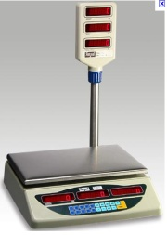
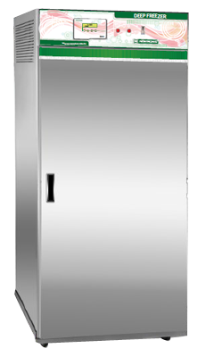
Charging Setups
From
Main cylinder
Preparation of Prototype
Refrigerated cylinder
Go up-to Vacuum level on -500 to 650 mm hg
Compound gauge
Vacuum pump
Weighing Scale
ON
Off after achieved Vacuum level on -550 to 760 mmHg
Off
ON
Shut off valve

Slide 5
Special care while gas charging
While gas charging first flush the system with N2.
Check for leakage, if any, with N2 (@250psig).
If leakage found braze the joint properly in such a way that flame of brazing torch will not weak any other OK brazing joint.
Use 0% silver brazing rod for Cu to Cu joint and 30% silver brazing rod for MS to Cu joint.
Evacuate the system with vacuum pump.
Charge the refrigerant by using weight method only.
The refrigerant system should never be left open in air, as it will absorb moisture instantly.

Slide 6
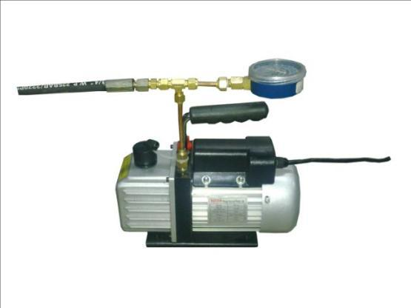
Vacuum Pump
FILKO ENGG. CO. [10, ROPEWALK STREET, BEHIND COMMERCE HOUSE, KALA GHODA, FORT MUMBAI-400 001, TEL. 022-2267 1858,
EMAIL ID –FILKOENG@VSNL.NET
57LPM
Weight : 6.7 kg

Slide 7
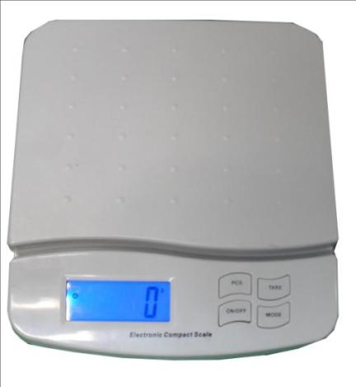
Weighing Scale
EUREKA WEIGHING SYSTEM PVT. LTD. ADDRESS: #101, ACHARYA INDUSTRIAL ESTATE, ANDHERI EAST,
MUMBAI - 400072
MOBILE: 9324525408 EMAIL-ID: EUREKAKATA@YAHOO.COM, EMAIL-ID: SALES@EUREKAKATA.COM WWW.EUREKAKATA.COM,
Weight : 1.1 Kg

Slide 8
THANKS

